Slide 1
Development of a close quarter, collision resistant drone (Name Needs Work)
Progress and Planning

Slide 2
Contents
Contents
Project Background
Issues with the original scope
Year 1
Year 2
Year 3
Plans

Slide 3
Project Background
My Interest
Want a masters.
Enjoy control theory.
CSIR Interest
HCD.
Moving into the drone space and mining research.

Slide 4
Project Background
Initial Project Scope
Develop an aerial platform that can autonomously navigate in an underground mine. To do inspection inside a box hole.
University Support
Electronic System Lab (ESL), Stellenbosch University.
Prof Japie Engelbrecht, Prof Johannes Treurnicht
CSIR Support
Part time masters.
20% of my time, which I have not taken
Only 3/4 weeks taken this whole year.

Slide 5
Issues with the original scope
Intrinsic Safety
Defined constraints based on SA regulations
Not a chance that drone will fly
GPS Constraints
GPS critical part of navigation and control system
Will need some more research, masters on it’s own
Final Decision, Out of Scope for this project
Final Scope
Focus on the disturbances introduced by the near wall effect and being in a confined environment.

Slide 6
Year 1
Researched intrinsic safety and explosion protection
Wrote a proposal for a Chevron RFP, got nothing…
Taught myself some Drone and Aerodynamic Theory
Did research on the disturbances found in mines
Investigated different drone types and frames
Did a mathematical comparison of different drone types and wrote a paper for ROBMECH. Presented.
Made concept designs
Decision was made to buy a custom drone found online and focus on the control

Slide 7
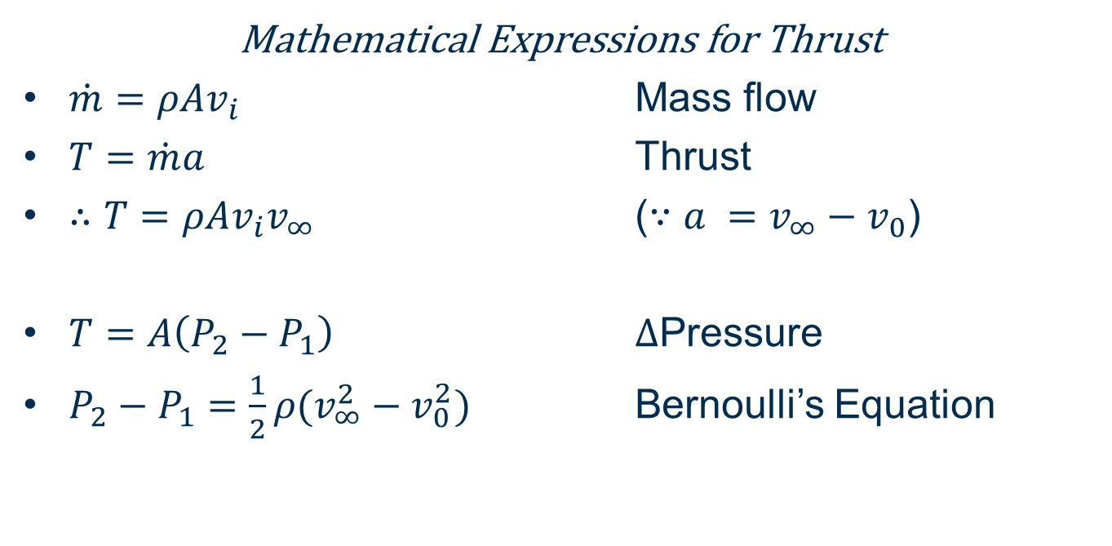
Fundamentals of Flight Theory
Mathematical Expressions for Thrust
$\dot{m}=ρAv_{i}$ Mass flow
$T=\dot{m}a$ Thrust
$∴T=ρAv_{i}v_{∞}$ ($∵a =v_{∞}−v_{0}$)
$T=A\left(P_{2}−P_{1}\right)$ $Δ$Pressure
$P_{2}−P_{1}=\frac{1}{2}ρ(v_{∞}^{2}−v_{0}^{2})$ Bernoulli’s Equation
Notes:
Mass flow
Power into the system takes the form of a pressure differential

Slide 8
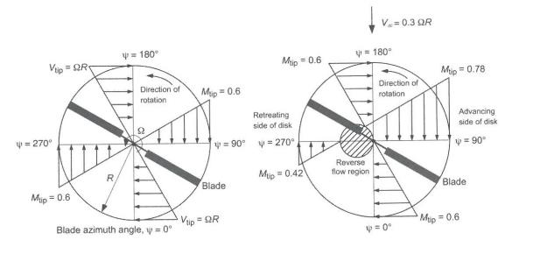
Fundamentals of Flight Theory
Velocity Components of a Rotor
Notes:
Different tip velocities
Max speed limitation

Slide 9
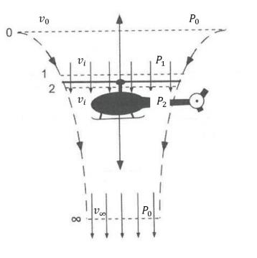
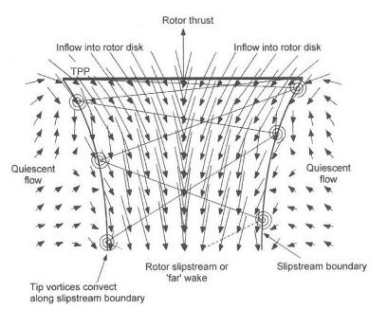
Fundamentals of Flight Theory
Momentum Theory in Hover
Wake Boundary
Notes:
Thrust created by the difference in Pressure between P2 and P1. Subscripts: 0 = Quiescient
1 = Just before rotor
2 = Just after rotor
inft = Far wake (one rotor diameter)

Slide 10
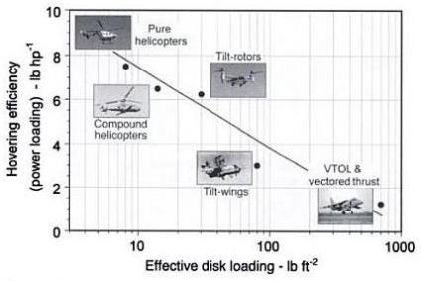
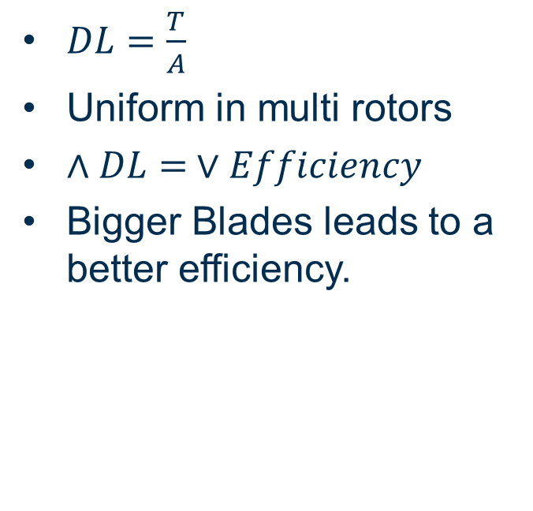
Fundamentals of Flight Theory
Disk Loading
$DL=\frac{T}{A}$
Uniform in multi rotors
$∧DL= ∨Efficiency$
Bigger Blades leads to a better efficiency.
Notes:
It is easier to push large amounts of air slowly, than small amounts of air fast.
Of course bigger blades also leads to: Large rotational inertia, severely limited flight speed, bigger geometry, less immune to gusts.

Slide 11
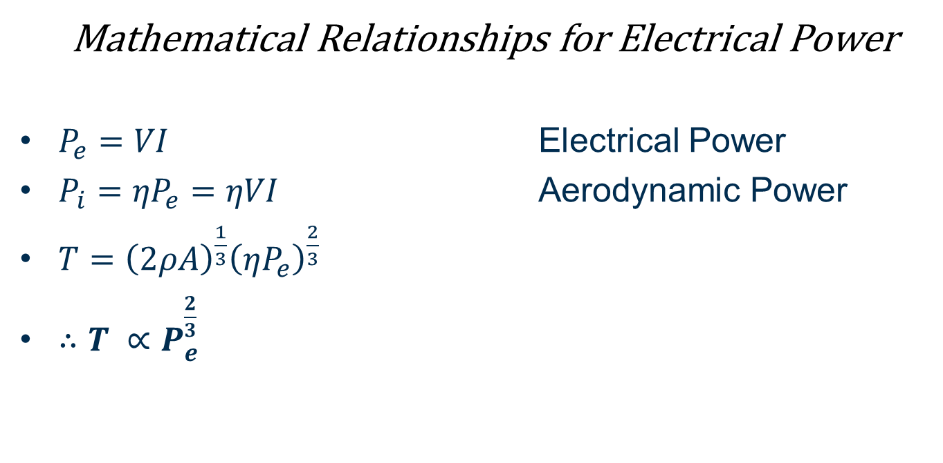
Fundamentals of Flight Theory
Mathematical Relationships for Electrical Power
$P_{e}=VI$ Electrical Power
$P_{i}={ηP}_{e}=ηVI$ Aerodynamic Power
$T={\left(2ρA\right)}^{\frac{1}{3}}{\left(ηP_{e}\right)}^{\frac{2}{3}}$
$∴T ∝P_{e}^{\frac{2}{3}}$
Notes:
Increasing Rotors doubles both the power into the system as well as the thrust where increasing the power only increases the thrust by about 1.5

Slide 12
Selection Parameters
Efficiency, Payload and Flight Time
Geometry, Size and Mechanical Complexity
Flight time linked to efficiency
Single rotor is more efficient than a multi rotor of a similar size.
Multi rotors can handle bigger payloads more efficiently.
Design for light weight
Functional weight distribution.
Symmetrical weight distribution.
Inertia Tensor Reduction

Slide 13
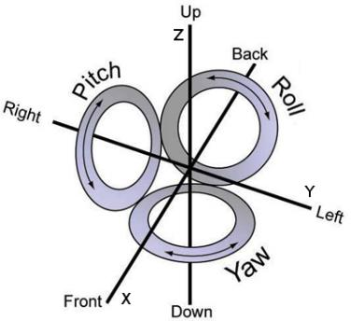
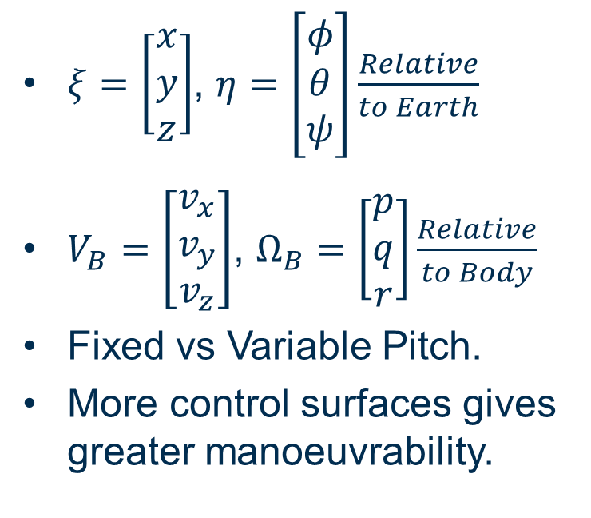
Selection Parameters
Drone Manoeuvrability Control
$ξ=\left[\begin{matrix}x \\ y \\ z\end{matrix}\right]$, $η=\left[\begin{matrix}φ \\ θ \\ ψ\end{matrix}\right]\frac{Relative}{to Earth}$
$V_{B}=\left[\begin{matrix}v_{x} \\ v_{y} \\ v_{z}\end{matrix}\right]$, $Ω_{B}=\left[\begin{matrix}p \\ q \\ r\end{matrix}\right]\frac{Relative}{to Body}$
Fixed vs Variable Pitch.
More control surfaces gives greater manoeuvrability.
Notes:
Rotation Matrix
As angle of attack changes drag increases, power consumption similar.

Slide 14
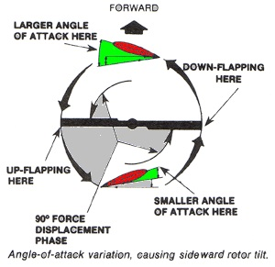
Selection Parameters
Stability and Disturbance Rejection
Big Design Specification for this project.
Inherent Yaw Instability.
Multiple blades increases disturbance immunity.
Rotor loss

Slide 15
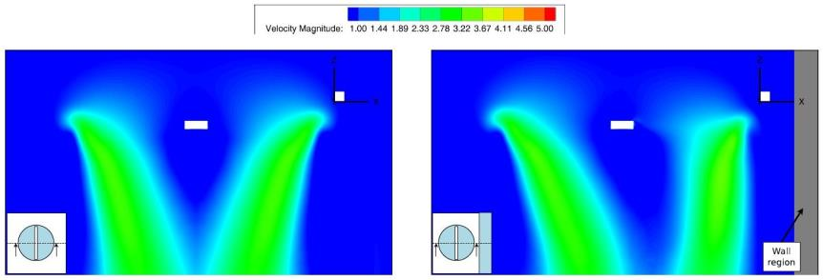
Near Wall Effect
Near Wall Effect

Slide 16
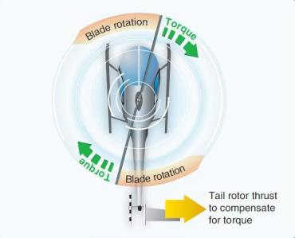
Standard Configurations
Traditional Helicopter
Low disk loading
High efficiency
Lengthy craft
High level of mechanical complexity
Very susceptible to disturbances
Limited payload

Slide 17
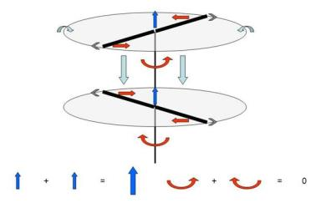
Standard Configurations
Coaxial Rotors
Low disk loading
High efficiency
Compact craft
Weak lateral control
High drag during translations
Limited payload

Slide 18
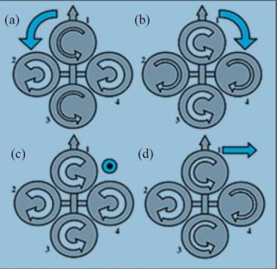
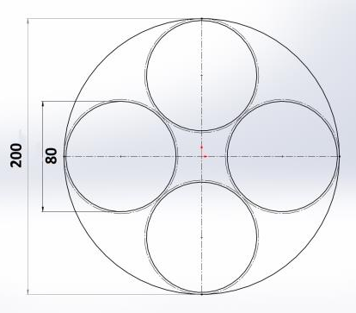
Standard Configurations
Multi Rotors
Very common design
High disk loading
Low efficiency
High payload
High disturbance rejection
Large Craft

Slide 19
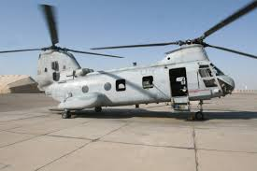
Standard Configurations
Tandem Rotors
Not a commonly used design
Jack of all trades

Slide 20
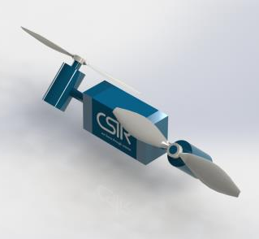
Concept Designs
Concept Design 1 – Tandem Tilt Rotors
Pros
Jack of all trades
Increased manoeuvrability
Compact Design
Cons
Difficult to control
Not much literature

Slide 21
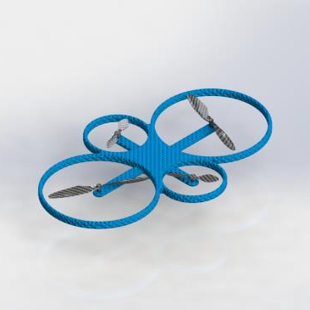
Concept Designs
Concept Design 2 – Unlike Size Quad
Pros
High Stability
Quadcopter manoeuvrability
Compact Design
Easy to control
Higher Payload
High Disturbance rejection
Cons
Lower efficiency

Slide 22
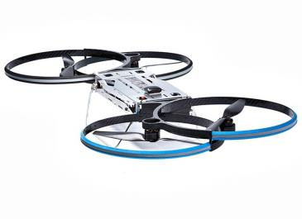
Concept Designs
Concept Design 3 – Overlapping Quad
Pros
High Stability
Quadcopter manoeuvrability
Compact Design
Higher Payload
High Disturbance rejection
Cons
Lower efficiency
Slightly more difficult to control

Slide 23
Year 2
Found a drone online
Investigated different flight controllers,
Investigated different deployable open source software
ArduPilot was the obvious decision
Look into the dev guides to ensure we have the level of access required, including simulation
Procurement of the drone
Battles with getting ardupliot to compile
Nope, still Battling…
Ardupilot Compiles
Learnt a lot of C++, still learning a lot (minimal experience prior), started playing around with the simulation.

Slide 24
Drone 3: Mally Aeronautics
Drone 3
Pros
Good configuration for handling the disturbances.
Rotor protection shrouds
Large Battery Life
PixHawk
Cons
Bad Mechanical Design
Low grade materials
Cons discovered on delivery

Slide 25
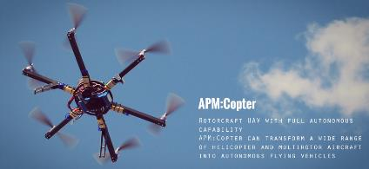
ArduPilot: APM:Copter
Open Source Software
Pros
Open Source & runs on the PixHawk flight controller
Complete control of the code
Thorough testing and usage
Multiple ready to use utilities
Cons
Spaghetti code with bad documentation
A lot of inheritance in the code, difficult to follow and make sense

Slide 26
Year 3
Set up the drone and learnt all the configuration tools, including a first flight mid year.
Started modifying the simulation code to represent our system
Spent a lot of time working through the ArduPilot code
Drew software diagrams for the code, and the implemented control loops
Started modifying parameters and then code, testing in simulation
After first flight, could not get the results from simulation as desired
Decision was made to make a Matlab/Simulink simulation
Been teaching myself Simulink and designing the simulation
Started testing with the gathered flight data
Bart arrives, adds great Simulink and theoretical control knowledge

Slide 27
Plans
2017
Finish Implementing the controller and plant in Simulink
Tune the existing controllers
Design Disturbance Observer Controller
2018 with Bart
Implement Near Wall Effect Disturbance in Simulink
Test Controller on it
Debug and tune
Generate data
2018 without Bart
Generate last bits of needed data
Write up, I want to ask for a month or 2 for writing up, even if I need to take unpaid leave for a bit of it

Slide 28
Thank you
for making me do this
Angus Steele (ASteele@csir.co.za)

